Slide 1
Become a Better C# Developer DevIntersection Decenber 2022
Kathleen Dollard
@KathleenDollard
Chet Husk
@ChetHusk

Slide 2

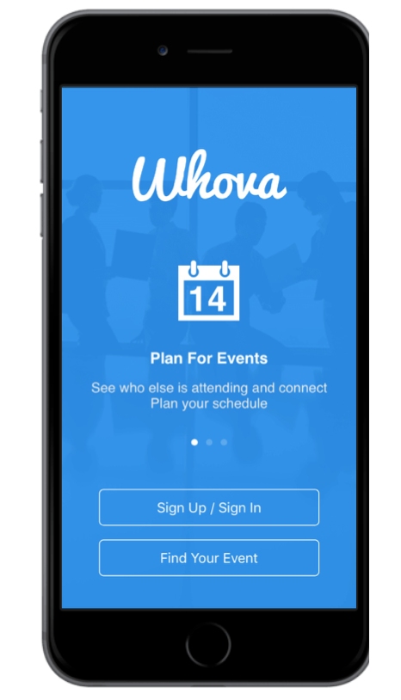
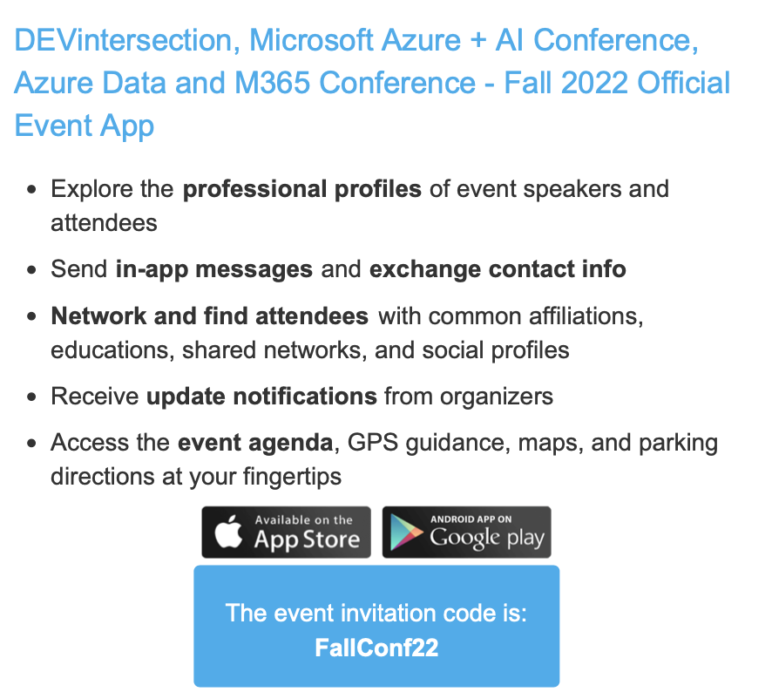

Slide 3
You'll learn more about the type system. Along with its garbage collector it remains the foundation of all variations of .NET. You'll see a sampling of ways that C# and the .NET can surprise you, in possibly unpleasant ways. You'll look back at effectively using delegates and generics, type hierarchies, and the complex signatures that can result from tuples and functional techniques. Modern development environments play a huge role in the quality of your code. Learn how to effectively use refactoring, use new Visual Studio features, and define the right set of code fixes and automatic formatting for your team. You’ll also leave with a set of productivity tips that will speed up your programming. You’ll explore how features in recent versions of C# work together to significantly simplify code. You’ll learn how to use pattern matching to apply algorithms to multiple and diverse objects, how string interpolation makes formatting strings much easier and clearer, how to create compound assignments and comparisons using Tuples and Deconstruction and how to use nullable reference types to reduce errors in your code. Throughout the day the focus is on how you can use these features and techniques to make the code you write better – more reliable, easier to comprehend, and better performing.

Slide 4
Opening

Slide 5
Agenda
8:00-9:15 | Introduction, types and memory review
9:15-9:30 | Break
9:30-10:45 | CI - Chet
10:45-11:00 | Break
11:00-12:15 | Puzzles
12:15-1:15 | Lunch
1:15-2:20 | Everyday C#
2:20-2:30 | Short break
2:30-3:00 | Summary

Slide 6
Go to Types slides

Slide 7

Puzzles!

Slide 8

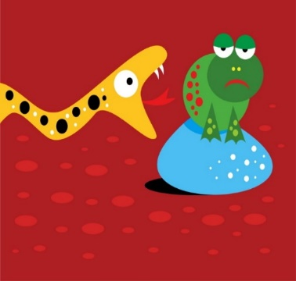
Cognitive Dissonance
Learning often requires breaking old associations
Your brain contorts to fit new input into existing perception
That’s being human
How do we help your brain avoid contorting input?
Explicit incorrectness
Clarify your mental model
Show it’s wrong
Or confirm it’s right
Clarify by verbalizing to another
Empathy
Forced clarity

Slide 9
Puzzle groups
Two or three people
Generally, not the people you came with
If you think you’re good, pair with someone you think might struggle
I’ll set out a puzzle in the form of a unit test
It will require a change to create a meaningful passing test
The discussion of ‘why’ is very important
There’s a time for everything
I want you to think, not experiment

Slide 10

DEMO
Puzzles!!

Slide 11

Resources @KathleenDollard (in my repos, be sure you get the right branch!!!)
Summary.txt for our wrap up is in the same directory as this slide deck
Sample puzzles https://github.com/KathleenDollard/sample-puzzles
Be sure to use the DevIntersection 2022-12 start and done branches
Type examples https://github.com/KathleenDollard/TypeExamples
Pattern matching:
Pattern matching in docs https://learn.microsoft.com/en-us/dotnet/csharp/fundamentals/tutorials/pattern-matching
Refactor into pattern matching demo https://github.com/KathleenDollard/sample-patterns]
Be sure to start with the `devintersection-2022-start` branch. Look for IDE features to help with many of the changes
If you want to compare with our final, use the `devintersection-2022-end` branch
Notes:
[Sample puzzles](https://github.com/KathleenDollard/sample-puzzles)
* Be sure to use the DevIntersection 2022-12 start and done branches
[Type examples](https://github.com/KathleenDollard/TypeExamples)
Pattern matching:
[Pattern matching in docs](https://learn.microsoft.com/en-us/dotnet/csharp/fundamentals/tutorials/pattern-matching)
[Refactor into pattern matching demo][https://github.com/KathleenDollard/sample-patterns]
Be sure to start with the `devintersection-2022-start` branch. Look for IDE features to help with many of the changes
If you want to compare with our final, use the `devintersection-2022-end` branch

Slide 12

Summary

Slide 13
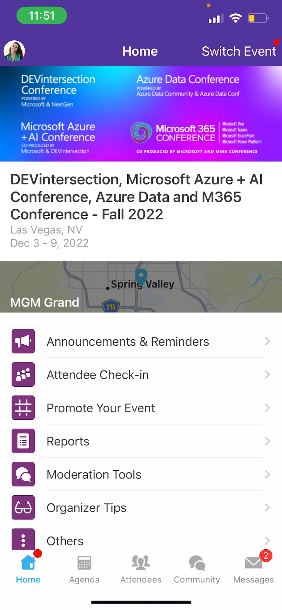
Session Feedback Surveys
In the pursuit of making our conferences even better, we need to hear your feedback about this session.
Here’s How -
Simply go to the Whova App on your smartphone
Go to the conference homepage
Scroll down to ‘Additional Resources’ and click ‘Surveys’.
Click ‘Session Feedback’.
Scroll down to click on this session title.
Complete the session feedback survey.
Finally, click ‘Submit’

Slide 14


Slide 15
Extras

